Slide 1

SKY RANCH MIDDLE SCHOOL
HOME OF THE THUNDERBOLTS
To Most People the sky is the limit--To Thunderbolts, the sky is Home!!

Slide 2

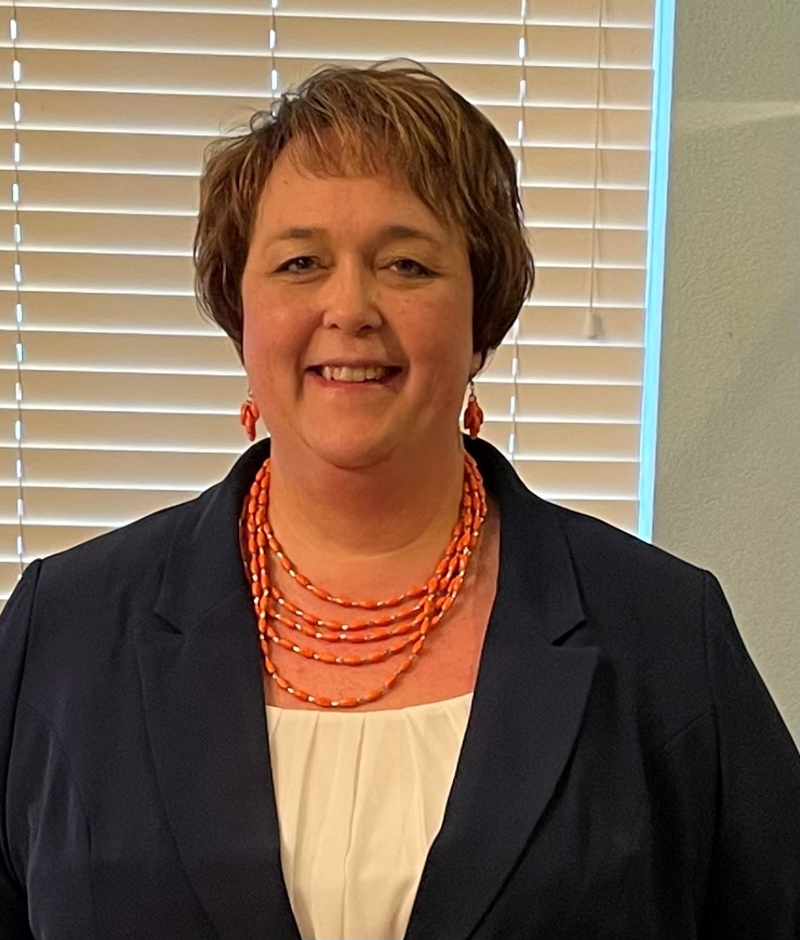

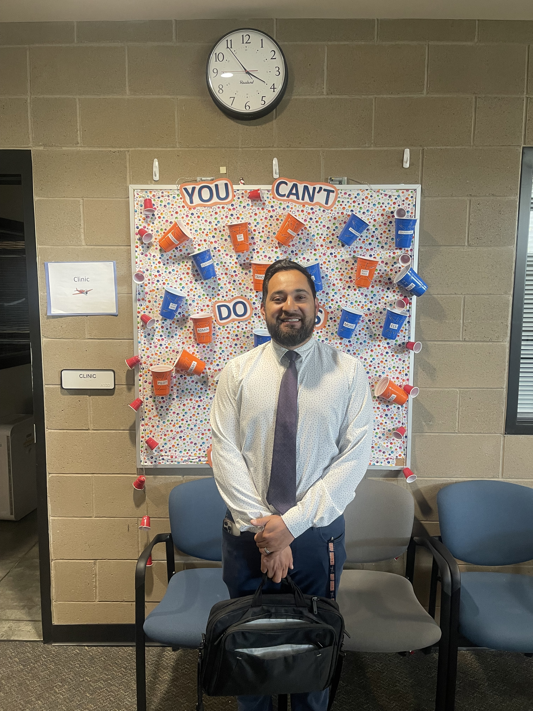
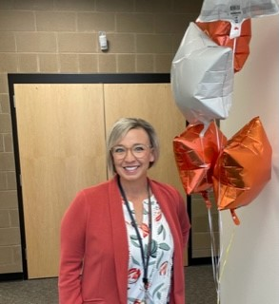
THUNDERBOLTS
BRAD NAUGHTON
Asst. Principal
KATI FITZPATRICK
Asst. Principal
HUGO GUILLEN
Dean
JILL BAYLISS
Principal

Slide 3
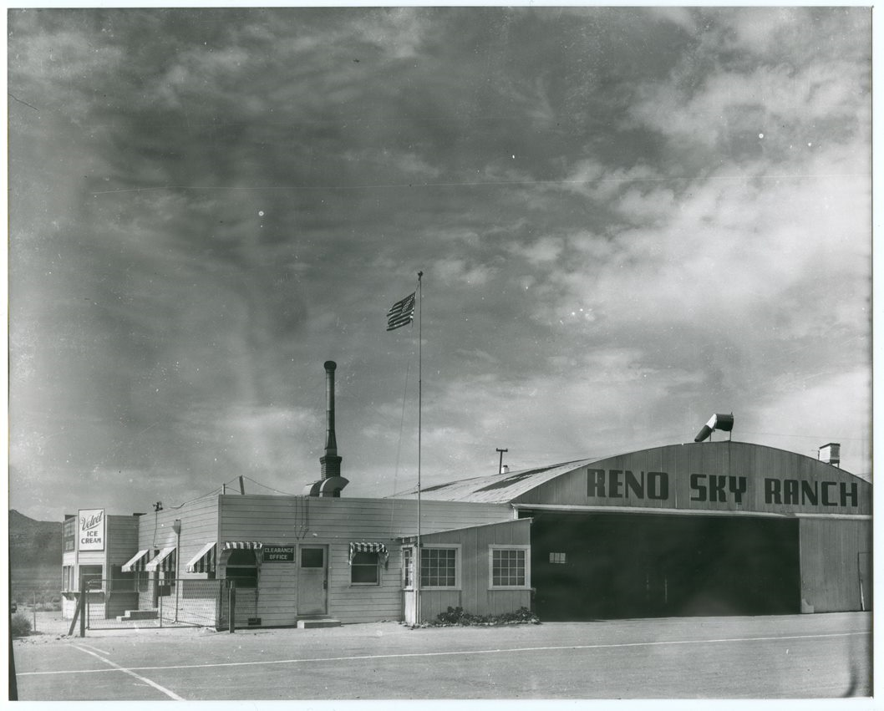
Original Sky Ranch Airport
Opened in November 1941
Closed 1970ish
Original site for RENO AIR RACES 1964 and 1965

Slide 4

OUR FLIGHT PLAN What we want our students to do!!
Sky Ranch Middle School builds Fearless young Leaders who demonstrate Integrity, Grit, Honesty, and Tolerance through their academic excellence and citizenship.
 | F FEARLESS: When fears are grounded, dreams take flight. | L LEADER: Know the way, go the way, show the way. | I INTEGRITY: Do the right thing even when no one is watching. | G GRIT: Perseverance and passion to keep you going. | H HONESTY: If you want to be trusted, be honest. | T TOLERANCE: A willingness to embrace another’s uniqueness.

Slide 5
SRMS GRADING POLICY
Philosophy of Grading
Grading should represent mastery of standards-based content.
Grading represents what a student is able to do!
HOW GRADING WORKS:
Grades are based on two categories—Classwork/Homework and Assessments/Projects
Classwork/Homework is 15%
Assessment/Projects is 85%
Multiple opportunities to succeed—retakes!!

Slide 6
STUDENT SCHEDULES
8th Grade Schedule
  Core Classes
    Math
    Science
    ELA
    Social Studies
  Electives
    2 periods—either semester or year long class
  Enrichment
ELECTIVES –8th Grade​
SEMESTER COURSES ​
Edgenuity
21st Century​
Agriculture​
Stem Lab​
Robotics​
Art​
Digital Drawing and Painting​
PE​
Total Fitness​
Conditioning
YEAR LONG COURSES​
Advanced Band​
Advanced Choir​
Advanced Orchestra​
Leadership​
Yearbook
Spanish

Slide 7
REGISTRATION
Please complete ON-LINE registration
Registration for Electives
  Electronic form for 6th—7th—or 8th. One submission!! Due June 1st
Website: www.washoeschools.net/skyranch

Slide 8
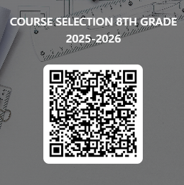
8th Grade Registration FORM
QR code for the Elective FORM
Use the links on the website to access the handouts and course descriptions.
QR Code for Elective FORM:

